Slide 1
PROJECTION OF LINES

Slide 2
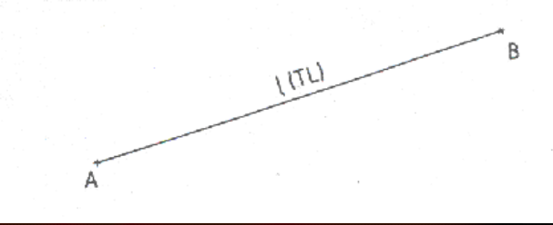
introduction
A straight line is defined as the locus of a point which moves unidirectionally.
The straight line can also be defined as the shortest distance between two points.
The projections of straight lines can be drawn by joining the respective projections of its end points.
The actual length of the line is commonly called true length and is denoted by T.L.

Slide 3
System of Notation
1. The actual line is denoted by capital letters A and B, or C and D etc in the question.
2. The front view (FV) of a line is denoted by their corresponding lower letters with dashes as a' and b', c' and d' etc.
3. The top view (TV) of a line is denoted by their corresponding lower case letters without dashes as a and b, c and d etc.
4. The side view (SV) of a line are denoted by their corresponding lower case letters with double dashes as a" and b", c" and d" etc.
5. Projectors are always drawn as continuous thin lines.
6. Line with specific thickness for a particular type of line.

Slide 4
Projections of a straight line lying in the first angle shall have its front view above xy and the top view below xy.
A clear concept of orthographic projections and projections of points is required to understand the projections of straight lines.

Slide 5
ORIENTATION OF A STRAIGHT LINE
A straight line may be in one of the following positions.
1. Line parallel to both horizontal plane (H.P.) and vertical plane (V.P.).
2. Line perpendicular to H.P. (and parallel to V.P.).
3. Line perpendicular to V.P. (and parallel to H.P.).
4. Line inclined to H.P. and parallel to V.P.
5. Line inclined to V.P. and parallel to H.P.
6. Line situated on H.P.
7. Line situated in V.P.
8. Line situated on both H.P. and V.P. (i.e., on the reference line, xy).
9. Line inclined to both the reference planes.
(a) Line inclined to both H.P. and V.P. such that θ + φ < 90°
(b) Line inclined to both H.P. and V.P. such that θ + φ < 90°

Slide 6
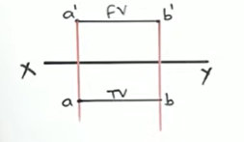
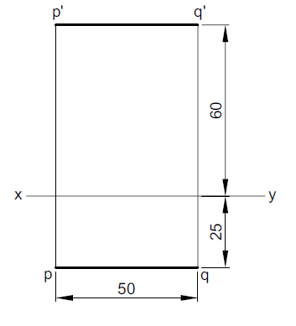
Line is parallel to both HP and VP
1. Line is parallel to both HP and VP
Problem 1: A 50 mm long line PQ is parallel to
both the H.P. and the V.P. It is 25 mm
in front of the V.P. and 60 mm above the H.P.
Draw its projections.

Slide 7

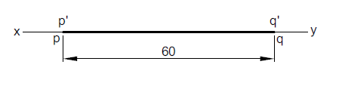
Line is on both HP and VP
2. Line is on both HP and VP
Problem 2: Draw the projections of a 60 mm long line PQ, which is situated both on the H.P. and the V.P.

Slide 8
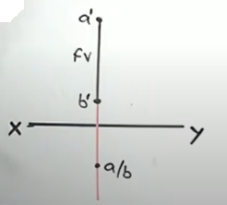
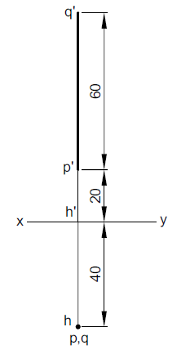
Line is perpendicular to HP and parallel to VP
3. Line is perpendicular to HP and parallel to VP
Problem 3: A 60 mm long line PQ has its end P 20 mm above H.P. The line is perpendicular to the H.P. and 40 mm in front of the V.P. Draw its projections.

Slide 9
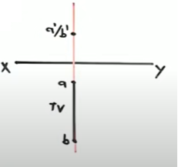
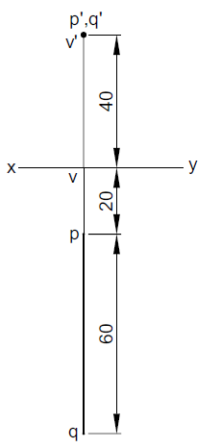
Line is perpendicular to VP and parallel to HP
4. Line is perpendicular to VP and parallel to HP
Problem 4: A 60 mm long line PQ has its end P 20 mm in front of the V.P. The line is perpendicular to the V.P. and 40 mm above the H.P. Draw the projections of the line.

Slide 10
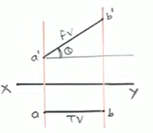
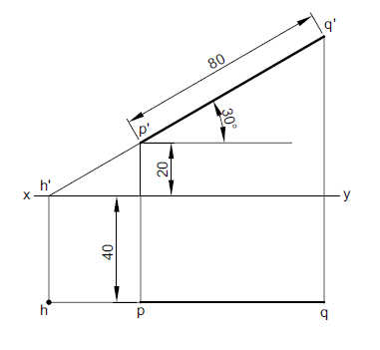
Line is inclined to HP and parallel to VP
5. Line is inclined to HP and parallel to VP
Problem 5: A 80 mm long line PQ has end P 20 mm above H.P. and 40 mm in front of the V.P. The line is inclined at 30° to the H.P. and is parallel to the V.P. Draw the projections of the line.

Slide 11
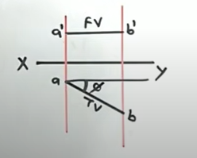
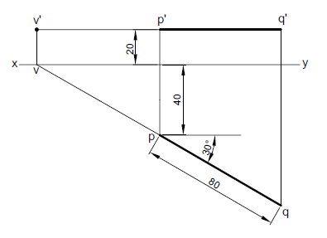
Line is inclined to VP and parallel to HP
6. Line is inclined to VP and parallel to HP
Problem 6: An 80 mm long line PQ is inclined at 30° to the V.P. and is parallel to the H.P. The end
P of the line is 20 mm above the H.P. and 40 mm in front of the V.P. Draw the projections of the line

Slide 12
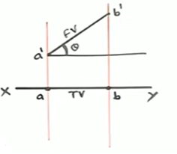
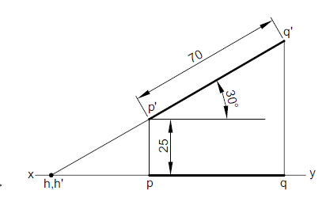
Line is inclined to HP and is in VP
7. Line is inclined to HP and is in VP
Problem 7: Draw the projections of a 70 mm long line PQ, situated in the V.P. and inclined at 30° to the H.P. The end P of the line is 25 mm above the H.P.

Slide 13
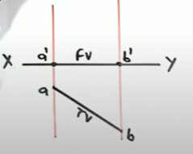
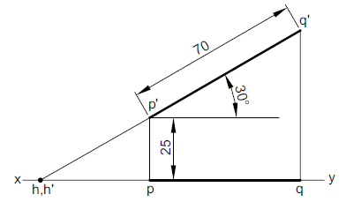
Line is inclined to VP and is in HP
8. Line is inclined to VP and is in HP
Problem 8: Draw the projections of a 70 mm long line PQ, situated in the V.P. and inclined at 30° to the H.P. The end P of the line is
25 mm above the H.P.

Slide 14
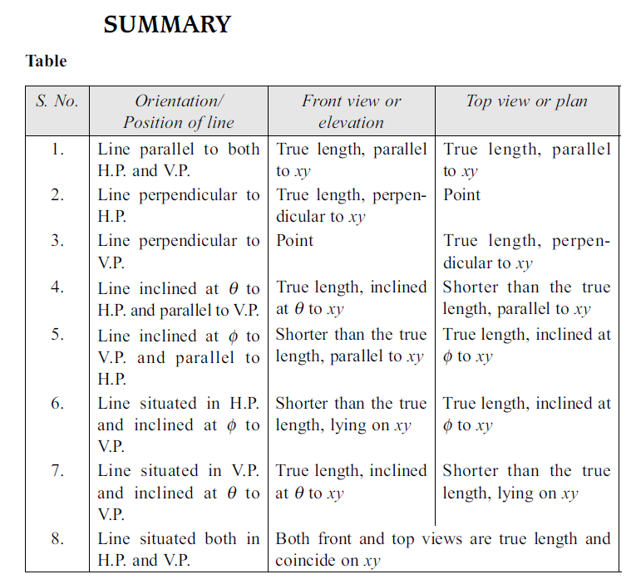
Line is inclined to VP and is in HP

Slide 15
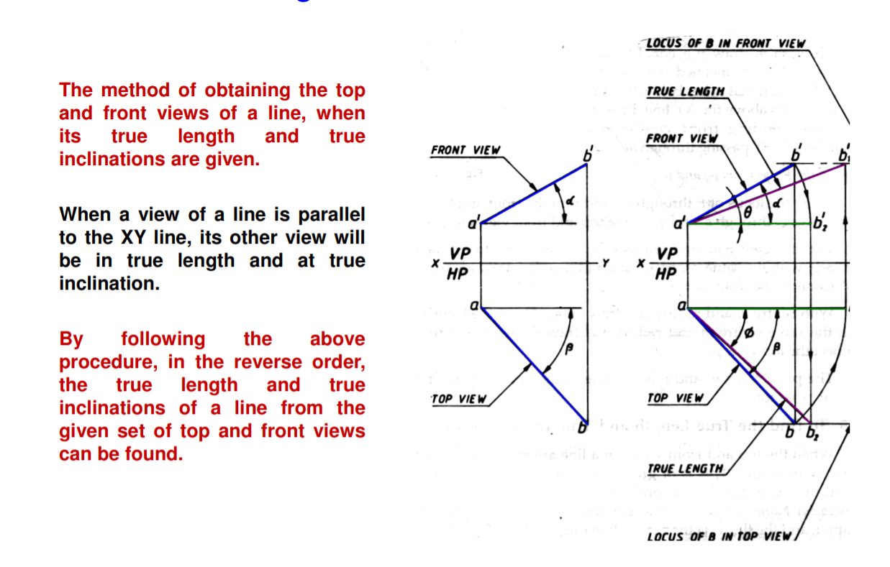
Line is inclined to both HP and VP
9. Line is inclined to both HP and VP

Slide 16
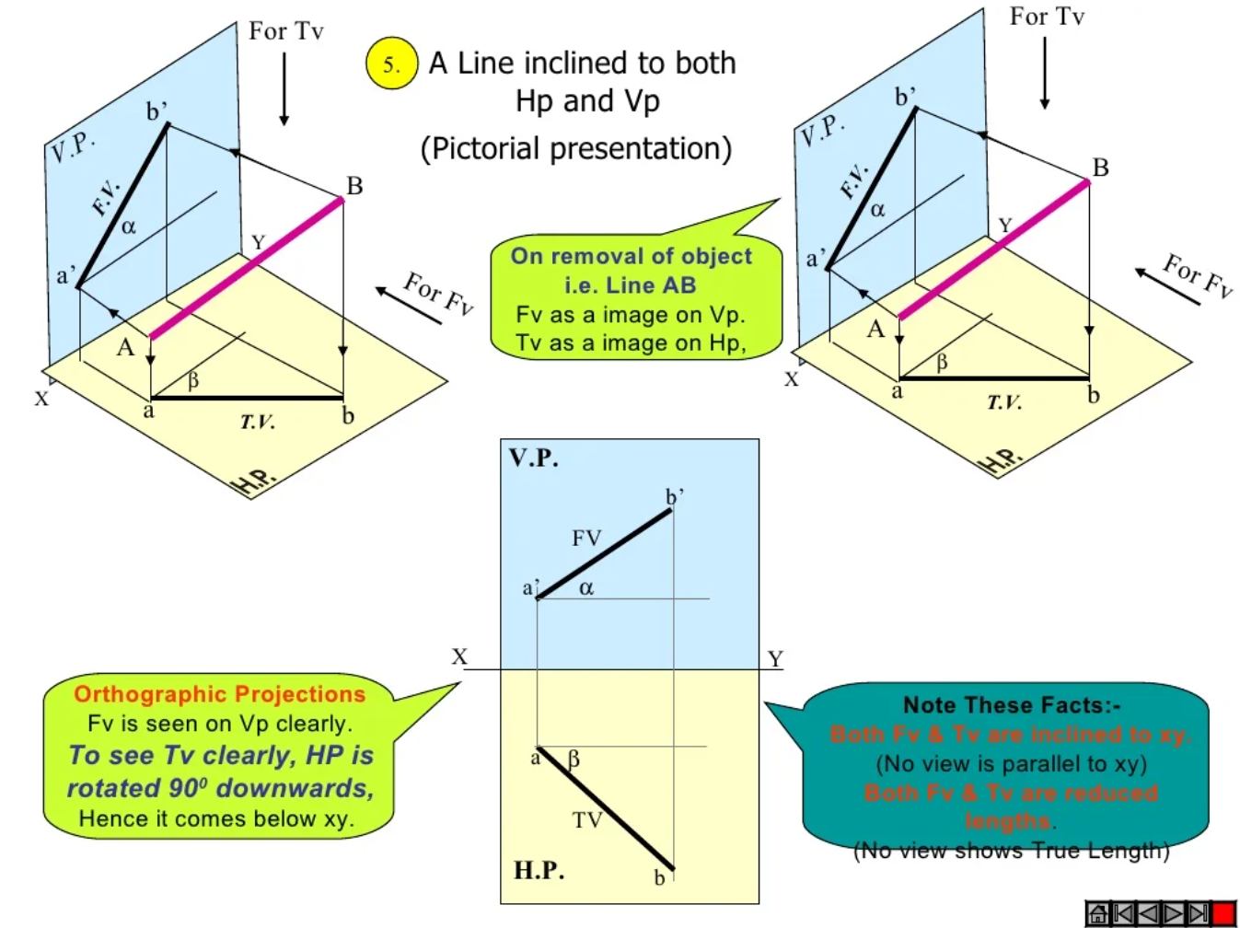
Line is inclined to both HP and VP

Slide 17
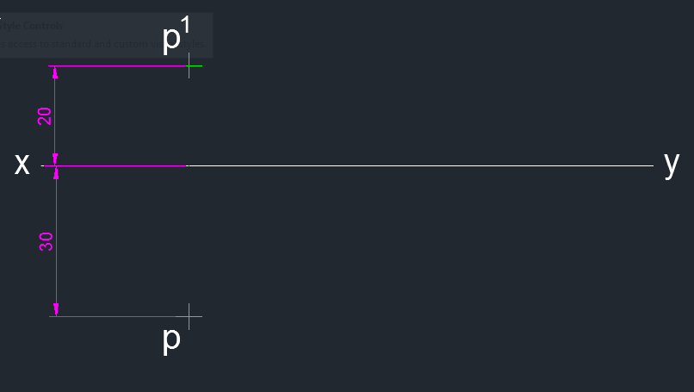
LINE INCLINED TO BOTH THE REFERENCE PLANES WHERE θ + φ < 90°
Problem 9: A 70mm long line PQ, has its end P 20mm above the HP and 30mm in front of the VP. The line is inclined at 45° to the HP and 30° to the VP. Draw its projections (Line inclined to both the reference planes where θ + φ < 90°)
Solution
Draw a reference line xy using Line command L.
Create a point p’ 20mm above xy and create a point p at a distance of 30mm below xy line using point command PO. Change the distance between the xy line and the point to 20 mm by using command Parametric - Dimensional constraints – Vertical. Mark the point as p' and p using Text command MTEXT.

Slide 18
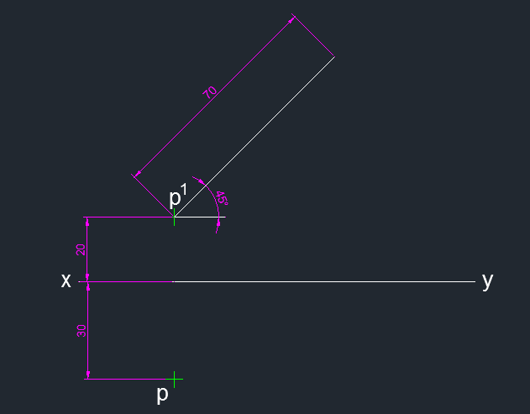
LINE INCLINED TO BOTH THE REFERENCE PLANES WHERE θ + φ < 90°
3. Draw a line of length 70mm from p' at an angle of 45° to xy. Use line command L, select first point p' and give @70<45 (Polar coordinates) for the line p'q'. Mark point q1' using Text command MTEXT. Dimension p'q1' line using Dimension commands DIMALI and DIMANG.

Slide 19
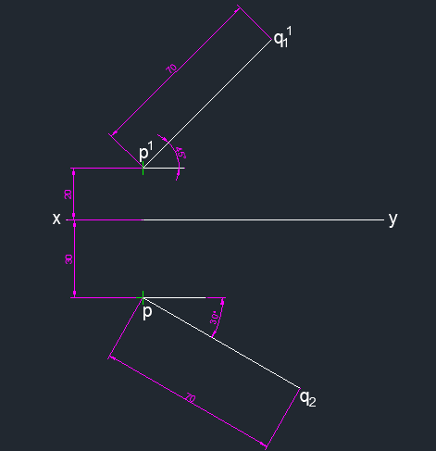
LINE INCLINED TO BOTH THE REFERENCE PLANES WHERE θ + φ < 90°
4. Draw a line of length 70mm from p at an angle of 30° to xy. Use line command L, select first point p and give @70<45 (Polar coordinates) for the line p'q'. Mark point q' using Text command MTEXT. Dimension p'q2 line using Dimension commands DIMALI and DIMANG.

Slide 20
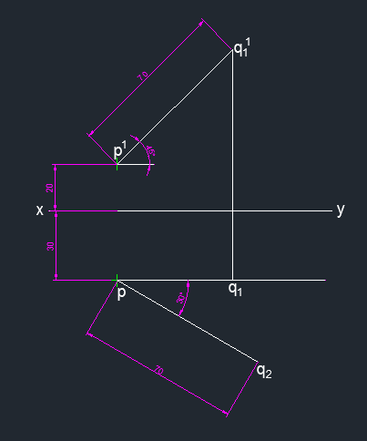
LINE INCLINED TO BOTH THE REFERENCE PLANES WHERE θ + φ < 90°
5. Draw a line from q1’ to meet the horizontal line from point p at q1 using Line command L. Mark point q1 using Text command MTEXT.

Slide 21
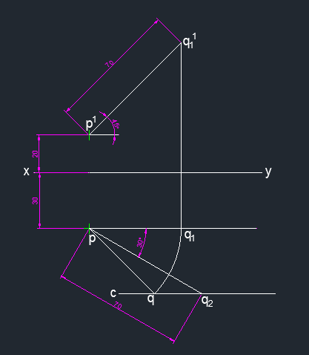
LINE INCLINED TO BOTH THE REFERENCE PLANES WHERE θ + φ < 90°
6. Draw a horizontal line at point q2. Draw a circle with center p and radius pq1 using Circle command C. Trim extra portions using Trim command TR. Mark point as q at the intersection of circle and horizontal line cq2 using Text command MTEXT. Draw a line joining pq to represent the top view.

Slide 22
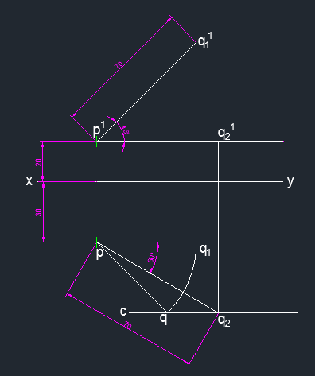
LINE INCLINED TO BOTH THE REFERENCE PLANES WHERE θ + φ < 90°
7. Draw a line from q2 to meet the horizontal line from point p' at q2' using Line command L. Mark point q2' using Text command MTEXT.

Slide 23
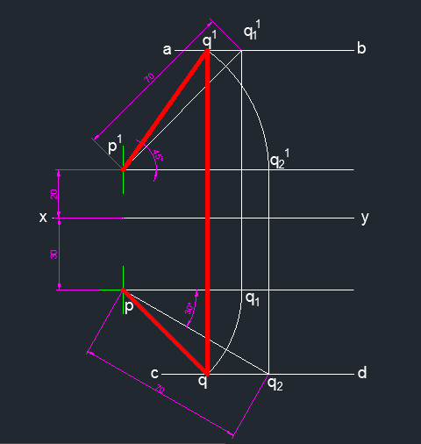
LINE INCLINED TO BOTH THE REFERENCE PLANES WHERE θ + φ < 90°
8. Draw a horizontal line at point q1'. Draw a circle with center p' and radius p'q2' using Circle command C. Trim extra portions using Trim command TR. Mark point as q' at the intersection of circle and horizontal line aq1' using Text command MTEXT. Draw a line joining p'q' to represent the front view.
9. Draw a line joining qq’ and ensure that the line is perpendicular to xy, to represent projector at the end Q.

Slide 24
LINE INCLINED TO BOTH THE REFERENCE PLANES WHERE θ + φ < 90°
10. Draw a horizontal line at point q1'. Draw a circle with center p' and radius p'q2' using Circle command C. Trim extra portions using Trim command TR. Mark point as q' at the intersection of circle and horizontal line aq1' using Text command MTEXT. Draw a line joining p'q' to represent the front view.
11. Draw a line joining qq’ and ensure that the line is perpendicular to xy, to represent projector at the end Q.

Slide 25
LINE INCLINED TO BOTH THE REFERENCE PLANES WHERE θ + φ < 90°
Conclusions
1. a is known as the apparent inclination with the H.P. The apparent inclination in the front view is
greater than the actual inclination of the line with the H.P., i.e., a > q.
2. b is known as the apparent inclination with the V.P. The apparent inclination in the top view is greater
than the actual inclination of the line with the V.P., i.e., b > f.
3. Neither the front view nor the top view represents the true length of the line PQ.

Slide 26
LINE INCLINED TO BOTH THE REFERENCE PLANES WHERE θ + φ < 90°
In the above problem, the notations used can be summarised as:
PQ Actual line in space
θ true inclination of line with the H.P.
φ true inclination of line with the V.P.
PQ1 Line assumed parallel to the V.P. and inclined q to the H.P.
p’q1’ front view of the line PQ1, representing true length and inclination with the H.P.
pq1 top view of the line PQ1, representing length equivalent to top view
PQ2 Line assumed parallel to the H.P. and inclined to the V.P.
p’q2’ front view of the line PQ2, representing length equivalent to front view.
pq2 top view of the line PQ2, representing true length and inclination with the V.P.
P’q’ Final front view of the line PQ
pq Final top view of the line PQ
α apparent angle made by the front view p’q’ with xy
β apparent angle made by the top view pq with xy

Slide 27
Determination of True Length and Inclinations with
Reference Planes
Problem 10: A straight line PQ has its end P 20 mm above the H.P. and 30 mm in front of the V.P. and the end Q is 80 mm above the H.P. and 70 mm in front of the V.P. If the end projectors are 60 mm apart, draw the projections of the line. Determine its true length and true inclinations with the reference planes.
Solution
Draw the projections of the line.
1. Draw a reference line xy. Mark points o and o1 on it such that they are 60 mm apart.
2. On the vertical projector through o, mark point p’ 20 mm above xy and point p 30 mm below xy.
3. On the vertical projector through o1, mark point q’ 80 mm above xy and point q 70 mm below xy.
4. Join p’q’ and pq to represent the front and the top views of the line, respectively.

Slide 28
Determination of True Length and Inclinations with
Reference Planes
Find true length (T.L.) and inclination (θ) of line with H.P.
5. Draw an arc with centre p and radius pq to meet the horizontal line from point p at point q1.
6. Project point q1 to meet horizontal line ab through point q’ at point q1’.
7. Join p’q1
¢. The length p’q1’ represents the true length of PQ. The inclination of p’q1’ with xy represents true inclination of PQ with H.P. Here, T.L. = 94 mm and θ = 40°.
Find true length (T.L.) and inclination (ϕ) of line with V.P.
8. Draw an arc with centre p’ and radius p’q’ to meet the horizontal line from point p’ at point q2’.
9. Project point q2’ to meet horizontal line cd through point q at point q2.
10. Join pq2. The length pq2 represents the true length of PQ. The inclination of pq2 with xy represents true inclination of PQ with V.P. Here, ϕ = 25°. Ensure that the length pq2 is equal to the length p’q1’.
Result
True length, p’q1’ = pq2 = 94 mm. Inclination with the H.P. θ = 40°. Inclination with the V.P. ϕ = 25°.

Slide 29
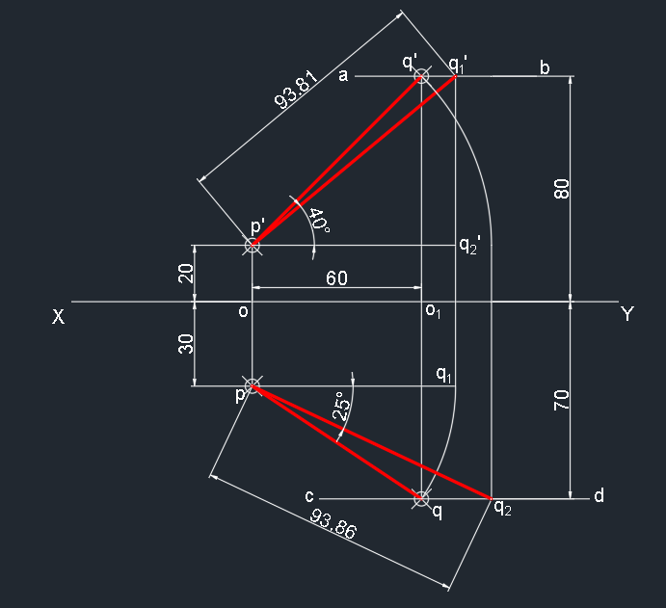
Determination of True Length and Inclinations with
Reference Planes

Slide 30
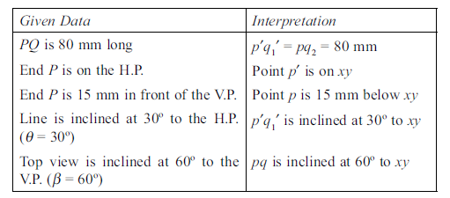
MISCELLANEOUS PROBLEMS
Problem 12: An 80 mm long line PQ has its end P on the H.P. and 15 mm in front of the V.P. The line is inclined at 30° to the H.P. and its top view is inclined at 60° to the reference line. Draw the projections of line PQ and determine true angle of inclination with the V.P.

Slide 31
Solution
1. Draw a reference line xy. Mark point p’ on xy and point p 15 mm below xy.
2. Draw an 80 mm long line p’q1’, inclined at 30º to xy.
3. Project point q1’ to meet horizontal line from point p at point q1.
4. Draw an arc with centre p and radius pq1 to meet a line pq inclined at 60° to xy at point q. Join pq to represent the top view.
5. Draw another arc with centre p and radius 80 mm to meet the horizontal line from point q at point q2.
Measure its inclination with xy as the inclination of line with the V.P. Here ϕ = 49°.
6. Project point q2 to meet the horizontal line through p’ at point q2’. Draw an arc with centre p’ and radius p’q2’ to meet the horizontal line through point q1’ at point q’. Join p’q’ to represent the front view.
7. Join q’q and ensure that it is perpendicular to xy, representing projector of the end Q.
Result Inclination with the V.P., ϕ = 49°.

Slide 32
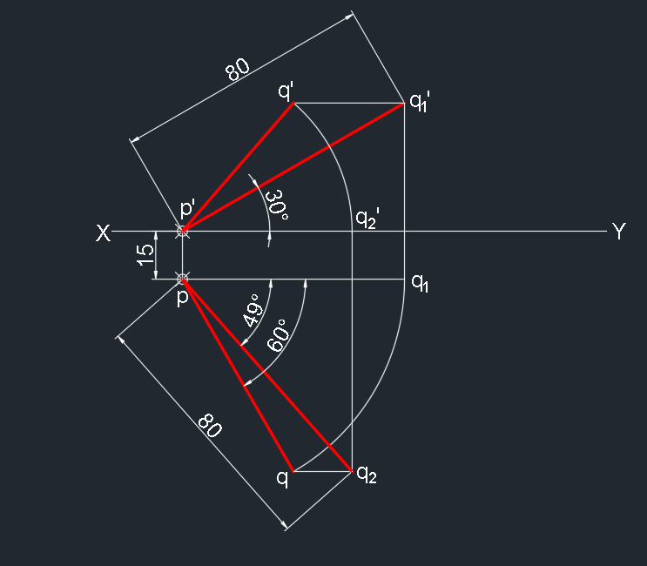

Slide 33
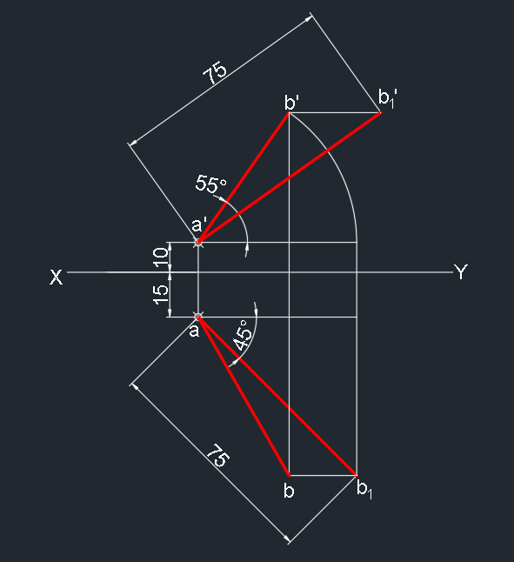
Problem 13: Line AB 75mm long line makes 45deg inclination with VP while its FV makes 55deg.End A is 10mm above HP and 15mm infront of VP. If the line is in 1st quadrant draw its projections and find its inclination with HP.

